Slide 1
Confluent Schema Registry
Shankar Sri Baabu M

Slide 2
Need of Schema Registry
Kafka Takes In Only Raw Bytes.
No Data Validation is done in Kafka.
We can add this Validation Logic in Kafka Cluster , But this will bring down the performance of Kafka.

Slide 3
Need of Schema Registry (Contd.)
We can move Validation logic to some System.
Confluent Schema Registry comes to Rescue.
Validation is done through Schema Registry.
The Data model can Change in Future , Leaving Consumer to Break in Runtime.

Slide 4
Various Schemas and Avro
We can use various Schemas such as JSON schemas , ProtoBuff etc in Schema Registry to perform Validation.
But If the data doesn’t have appropriate Schema, Producing data to the topic will still fail. But it lacks the support to adapt evolution (Data Model Change / Schema Change)
We can Adapt Data Model Change By leveraging Apache Avro with Schema Registry.

Slide 5
Various Schemas and Avro Contd.
Avro is a Serialization Tool to serialize data based on Schemas and Adapt the data Model Change (Schema Change) without breaking.
Avro is Nothing but JSON with Schema.
Schemas are also written as JSON

Slide 6
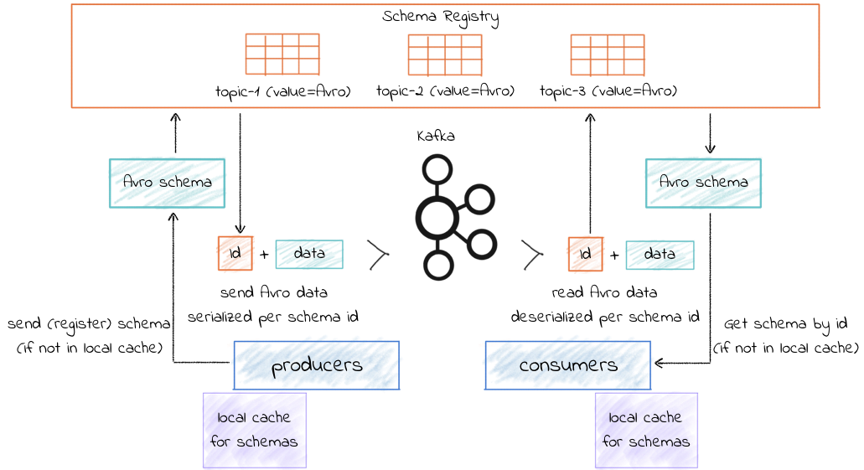
Schema Registry in Kafka Architecture

Slide 7
Operations With Schema Registry
Add Schema / Store Schema – Schemas are Cached in Registry and Stored in a Kafka Topic .
Delete Schema.
Update Schema.
Fetch Schema.
All these operations are Carried out Using its REST Api.

Slide 8
Compatibilty
Apache Avro provides Adaptability to Data Model Changes to an Extent. We term it as Compatibility.
The Schema Registry Supports Three Compatibility Modes:
Forward Compatibility:
Producer can Use New Schema, Without breaking the Consumer.
BackWard Compatibility:
Consumer Can Use New Schema , To consume data Produced using Old Schema.
Full Compatibility:
Forward + Backward.

Slide 9
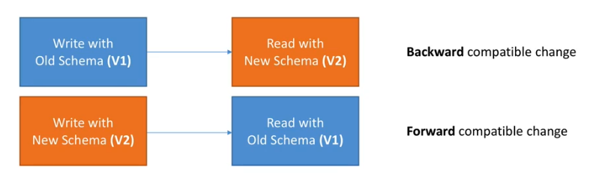
Compatibilty Contd.

Slide 10
Installation Guide
https://docs.confluent.io/platform/current/schema-registry/installation/index.html - Requires Confluent SDK/CLI – Linux OS Required.
Simple Quick Start to get Hands On Will be launching Landoop Kafka Cluster Image as Docker Container – provided the Docker Compose File in Git Repo.
https://github.com/sribaabu/kmc - GitHub for Resources.

